Slide 1





JESS FACKLER, MADELYN FORSTER, BREALIN REDECKER​
FAN ATTENDANCE
IN THE MLB
MAS766 - TEAM 2
1.
1.

Slide 2

OUR MOTIVATION:
WHAT FACTORS IMPACT MAJOR LEAGUE BASEBALL ATTENDANCE?
Purpose?
Identify fan engagement patterns
Provide actionable insights
Support evidence based decisions
Related Articles?
Article 1
Article 2
Key Variables?
Dependent: Attendance
Independent: Days of the Week, Game Time, Weather, Star Power, Ballpark, Game Type, Divisional Game, Same League Game, Point In Season
1.

Slide 3

DATA DESCRIPTION
Source:
FanGraphs, baseballR, and ESPN
Time Span:
2015 - 2025
Metric | Value
Total Records | 23,323 Games
Total Variables | 21
Date Range | April 5th, 2015 – November 1st, 2025
5.

Slide 4
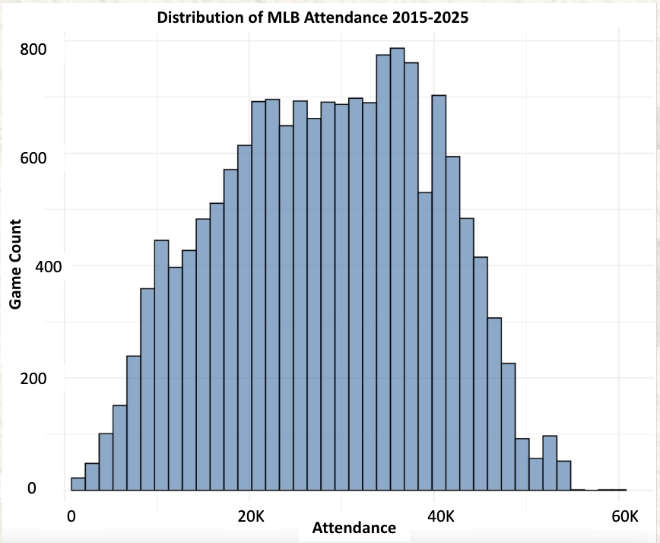
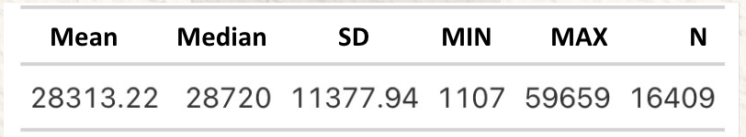
ATTENDANCE
2.
Notes:
A distribution of attendance – to make it more normal that was over 4 standard deviations away from the mean
-this helped our dependent variable look more normal allowing us for better analysis

Slide 5
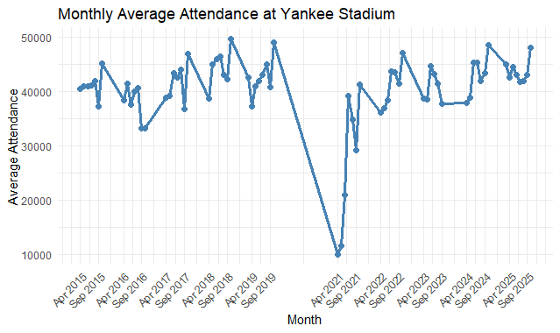



COVID-19
COVID-19 Dip/No 2020 Season
2.
Notes:
The 2020 and 2021 seasons were affected – as you can see in the graph, there is a massive dip in attendance during the early 2021 season. The 2020 season wasn't even included in the data because no fans were allowed in the ballparks, the season didn't even get to the regular season. The 2021 season started to allow fans in, but that number was capped at a certain amount. Because of this, we thought best to include a COVID-19 dummy that captures this effect.

Slide 6
Independent Variables
23,323 observations
Variable | Unique Values | Most Common
Home Team | 30 | LAD
Away Team | 30 | LAD
Venue Name | 53 | Citi Field
Game Type | 5 | R
Day of Week | 5 | Friday
Start Time | 7 | 7 PM
Part of Season | 4 | 1, 2
Other Weather | 10 | Partly Cloudy
Division Game | 2 | 0
AL or NL Game | 2 | 0
COVID | 2 | 0
Categorical:
Quantitative:
Variable | Mean | St. Dev | Q1 | Median | Q3
Temperature | 73.39 | 10.34 | 68.00 | 73.00 | 80.00
3.
Notes:
Our dataset had 23,323 obersvations with 21 variables and of those variables, we chose 12 to be our indendependent variables because we thought they would all help us predict attendance. These tables show the categorical variables and quantative variables tables giving a description of both. For the categorical variable, the unique values are shown as well as the most common occurrence. Whereas for the temperature variable, normal summary stats are used.
Game type includes regular season and different playoff formats like wild card, league series, etc
Part of season breaks the season into different parts – which helps us capture the games later in the season holding more weight because those games have higher playoff implications
Other weather gives a more in depth look at the climate of the game and adds to the temperature variable. There are values like snowy, partly cloudy, rainy, etc
Division game lets us know if the game is being played amongst teams with the same division
Because naturally, a game between the Chicago Cubs and St. Louis Cardinals will hold more intensity than a game between the Chicago Cubs and Anaheim Angels.
Al or NL game is the same as division variable, instead it's based off league
Covid, like I mentioned earlier, included a dummy for the covid variables

Slide 7
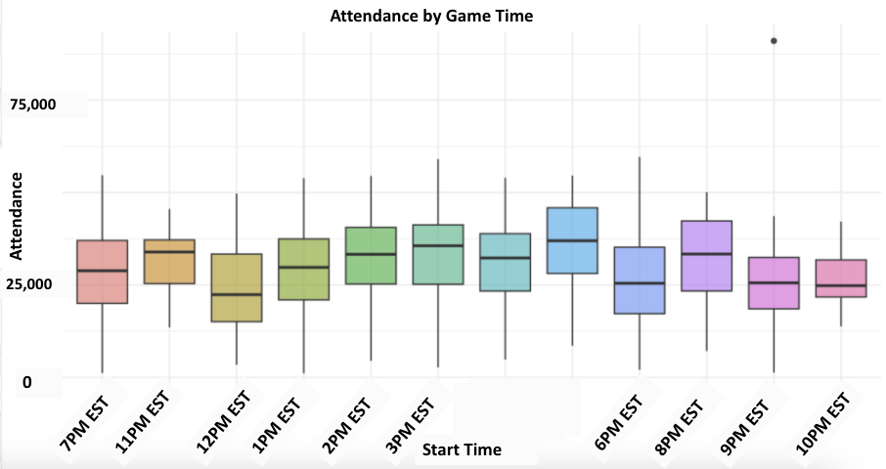
DATA DESCRIPTION
11AM EST
Graph 3
Game Time vs. Attendance
6.
Notes:
Here is a graph of attendance compared to game time with 7 PM EST being the baseline.
-wanted to include this to get the effect that game time has on attendance because people have work and extracurriclars, they might not be as included to go to a game at 12PM or 10PM hence the lower attendance

Slide 8
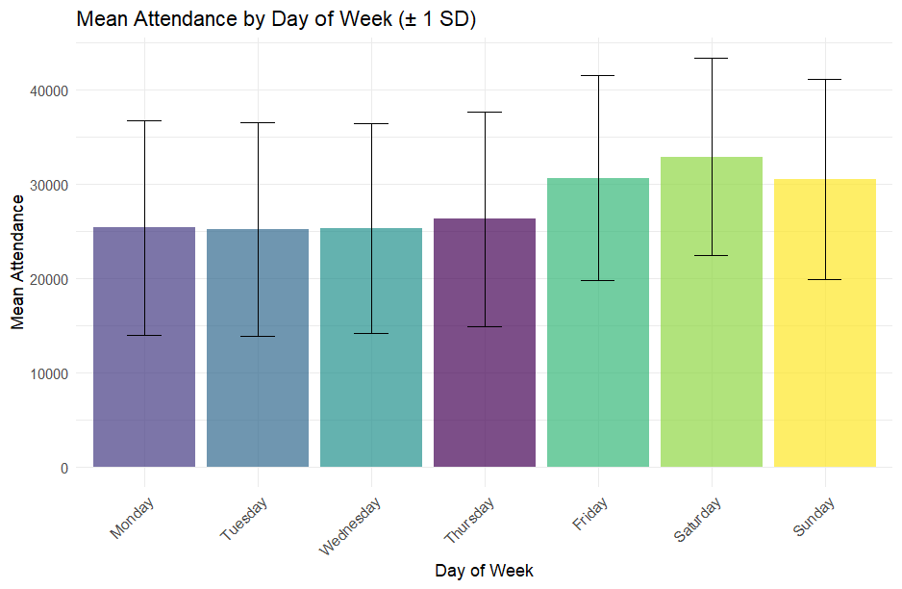
DATA DESCRIPTION
Attendance by Day of Week
40,000
AVG Attendance
10,000
0
Monday
Tuesday
Wednesday
Thursday
Friday
Saturday
Sunday
Day of Week
Graph 4
Day of the Week vs. Attendance
6.

Slide 9
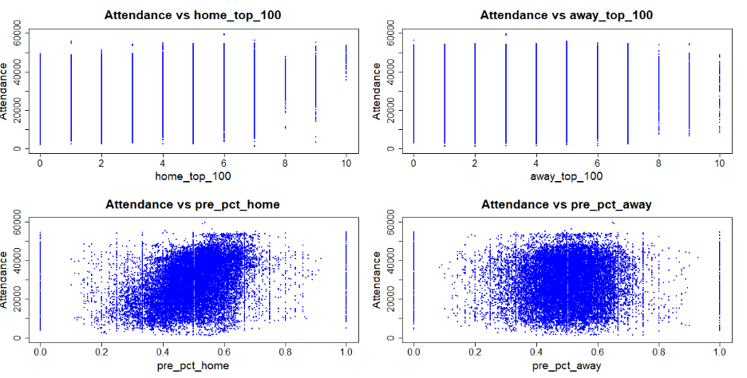
Residual Analysis
6.

Slide 10
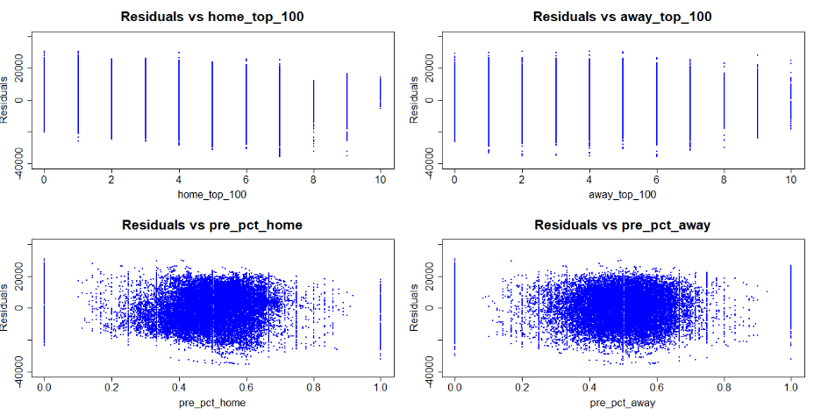
Residual Analysis
6.

Slide 11
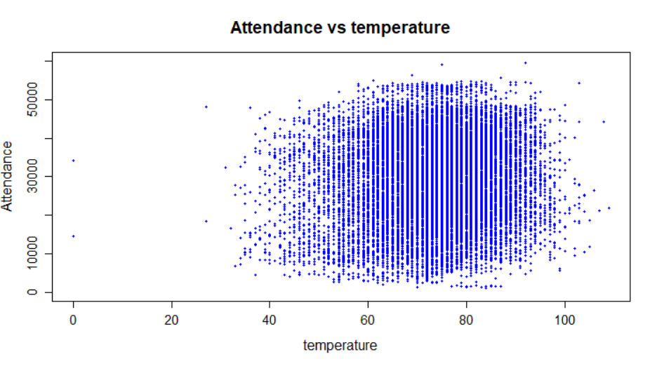
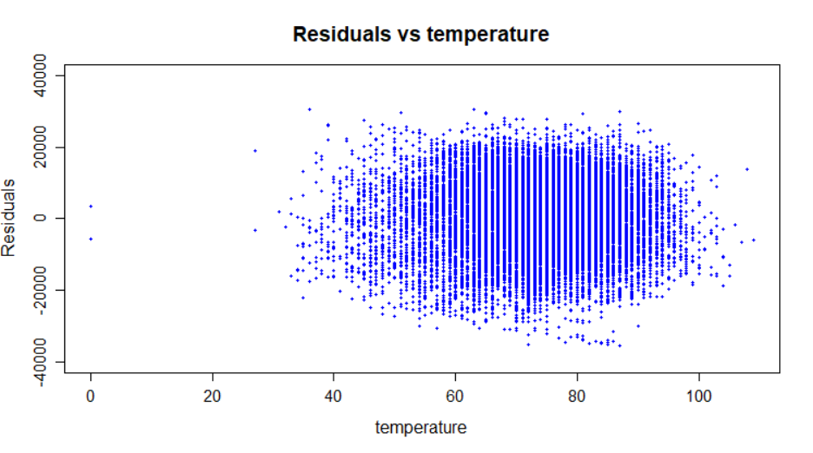
Residual Analysis
6.

Slide 12
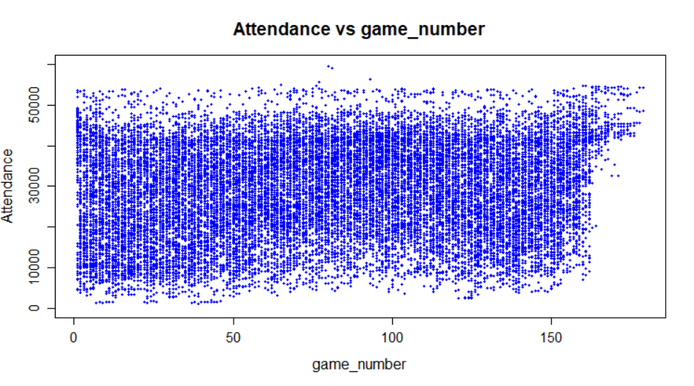
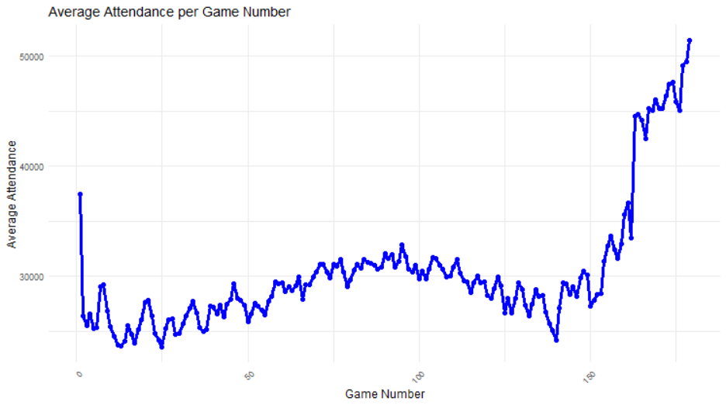
Residual Analysis
6.

Slide 13
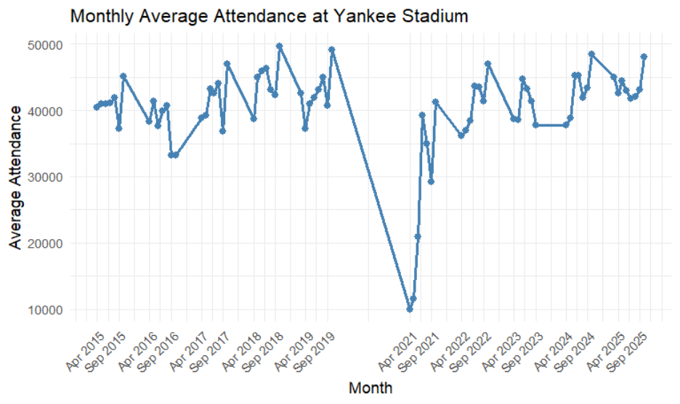
Seasonality
6.

Slide 14
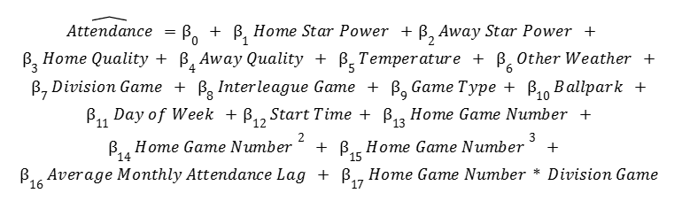
Final Model
6.

Slide 15
Model Evaluation
 | Model 1 | Model 2 | Model 3 | Model 4 | Model 5 | Model 6 | Model 7 | Model 8
MSE | 83180754 | 1084059815 | 46423764 | 1084054419 | 46,161,205 | 40,674,495 | 40,602,686 | 34,954,399
MAE | 7614 | 31243 | 5489 | 31243 | 5,473 | 5,112 | 5,098 | 4,696
R^2 | 0.159 | 0.126 | 0.607 | 0.576 | 0.610 | 0.707 | 0.710 | 0.737
Models 1-5 were built from 2015-2024 while models 6-8 used only 2015-2024 due to the inclusion of a seasonality term
All of 2025 was kept out of model for validation
6.

Slide 16
Results
Variable | Coefficient | Std. Error | t-value | p value
Intercept | 9656 | 640 | 15.08 | 0.000
Home Star Power | 866 | 29 | 30.22 | 0.000
Away Star Power | 335 | 23 | 14.50 | 0.000
Home Winning % | 4298 | 470 | 9.14 | 0.000
Away Winning % | 214 | 434 | 0.49 | 0.622
Temperature (F) | 35 | 6 | 5.48 | 0.000
6.

Slide 17
Results
Variable | Coefficient | Std. Error | t-value | p value
Division Game** | 571 | 190 | 3.01 | 0.003
Interleague Game** | 1647 | 130 | 12.71 | 0.000
Division Series* | 6437 | 723 | 8.91 | 0.000
Wild Card Game* | 10679 | 1257 | 8.50 | 0.000
League Championship* | 6593 | 868 | 7.60 | 0.000
World Series* | 2578 | 1353 | 1.91 | 0.057
Division*Game Number | -4 | 2 | -1.94 | 0.053
*Reference is Regular Season
**Dummy Variable
6.

Slide 18
Results
Variable | Coefficient | Std. Error | t-value | p value
Cloudy | -568 | 166 | -3.42 | 0.001
Dome | -1678 | 989 | -1.70 | 0.090
Drizzle | -1772 | 593 | -2.99 | 0.003
Overcast | -790 | 230 | -3.44 | 0.001
Partly Cloudy | -145 | 141 | -1.03 | 0.303
Rain | -1634 | 622 | -2.63 | 0.009
Roof Closed | -577 | 257 | -2.25 | 0.024
Snow | 9929 | 5609 | 1.77 | 0.077
Sunny | -876 | 204 | -4.30 | 0.000
*Reference is Clear
6.

Slide 19
Results
*Reference is Citi Field (NYM)
Variable | Coefficient | Std. Error | t-value | p value
American Family Field | 105 | 448 | 0.23 | 0.815
Angel Stadium | 4628 | 410 | 11.28 | 0.000
AT&T Park | 8367 | 453 | 18.49 | 0.000
BB&T Ballpark | -22351 | 3966 | -5.64 | 0.000
Busch Stadium | 7558 | 352 | 21.50 | 0.000
Chase Field | -3603 | 400 | -9.01 | 0.000
Citizens Bank Park | 1211 | 339 | 3.58 | 0.000
Comerica Park | -2912 | 354 | -8.22 | 0.000
Coors Field | 3788 | 352 | 10.78 | 0.000
Dodger Stadium | 8916 | 359 | 24.83 | 0.000
Fenway Park | 2089 | 338 | 6.18 | 0.000
Globe Life Field | -939 | 482 | -1.95 | 0.051
Great American Ball Park | -5116 | 349 | -14.66 | 0.000
Guaranteed Rate Field | -4929 | 388 | -12.71 | 0.000
Kauffman Stadium | -5262 | 354 | -14.85 | 0.000
Variable | Coefficient | Std. Error | t-value | p value
loanDepot Park | -9673 | 522 | -18.51 | 0.000
Minute Maid Park | -80 | 409 | -0.20 | 0.844
Nationals Park | -2847 | 340 | -8.38 | 0.000
Oakland Coliseum | -9698 | 379 | -25.57 | 0.000
Oracle Park | 2864 | 444 | 6.44 | 0.000
Petco Park | 2191 | 346 | 6.34 | 0.000
PNC Park | -5544 | 348 | -15.95 | 0.000
Progressive Field | -3585 | 514 | -6.98 | 0.000
Rogers Centre | 2386 | 362 | 6.60 | 0.000
T-Mobile Park | 712 | 444 | 1.60 | 0.109
Target Field | -2600 | 353 | -7.37 | 0.000
Tropicana Field | -8932 | 1043 | -8.56 | 0.000
Truist Park | 2636 | 438 | 6.02 | 0.000
Wrigley Field | 3900 | 341 | 11.43 | 0.000
Yankee Stadium | 6939 | 343 | 20.21 | 0.000
6.

Slide 20
Results
Average Attendance Lag was statistically significant with a p-value of 0.000
The cubic term of home game number was also significant at the 0.05 level
6.

Slide 21
Results
F-Statistic: 511.3
P-Value: 0.000
For practically any significant level, the coefficients of our final model are jointly significant
6.

Slide 22
Conclusion
Successfully modeled MLB attendance from the 2015-2025 seasons
Found coefficients to follow intuitive relationships of a fan's desire to attend a given game during the season
Discovered useful insights that can be applied to teams across the industry and help improve their ticketing strategies
6.

Slide 23
THANK YOU FOR WATCHING
6.

